Slide 1
Baylor x Credera: Software Engineering II
Spring 2024
Notes:
GD

Slide 2
Introductions
Expectations
Project Overview
Mentor/Team Collaboration
Technology Stack
Template Project Walkthrough
Questions
Notes:
GD

Slide 3
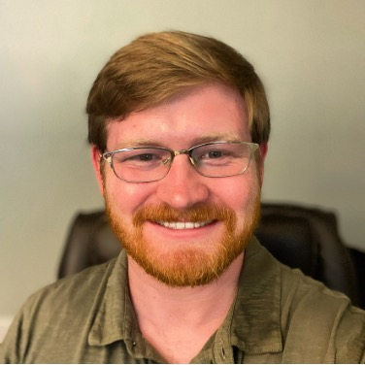
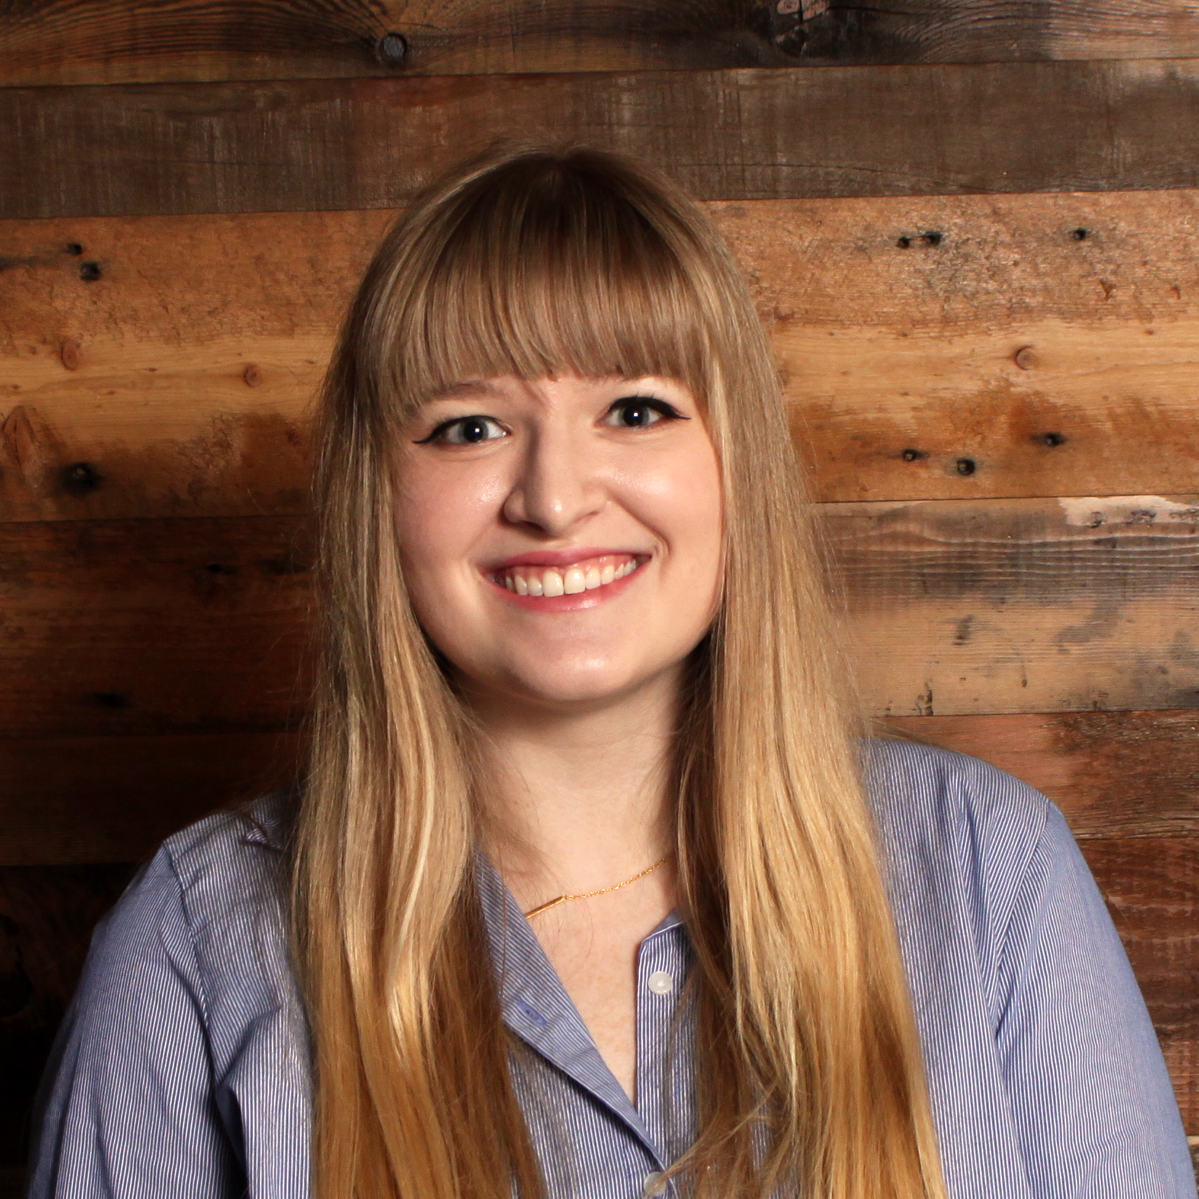
OUR TEAM
Nick Blair
Senior Consultant, Security & Privacy
Nick is a Consultant with the Security & Privacy capability at Credera. He has experience in network logging and monitoring, security framework implementation, contract review, physical security, and Governance, Risk & Compliance. At Credera beyond S&P, he has worked as a full stack developer with several client projects. He holds a Bachelor of Engineering in Computer Engineering from Vanderbilt University and a Master of Science in Education from Baylor University. He lives in the Dallas area with his wife and son.
Before coming to Credera, Nick served as a director of Residential Colleges at Baylor University and SMU.
Logan Parmeter
Senior Consultant, Technology Solutions
Logan Parmeter is a Senior Consultant in the Technology Solutions practice at Credera. She graduated with a BS in Computer Science from Baylor University in 2019. Logan has experience using various technologies including C, C++, Java, ReactJS, Swift, SwiftUI, Spring, Objective C, Kotlin, and Google Firebase. She has worked on various mobile applications at Brinker International, Handy, Angi, and Hilton.
In my free time, I enjoy crafting (sewing, knitting, crochet, drawing, etc.) and listening to audiobooks. I'm currently listening to the Star Wars Legends books.

Slide 4
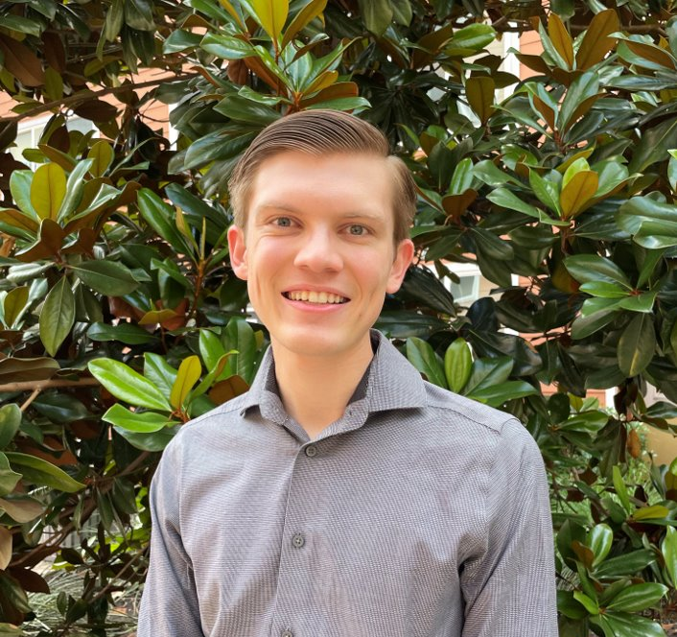
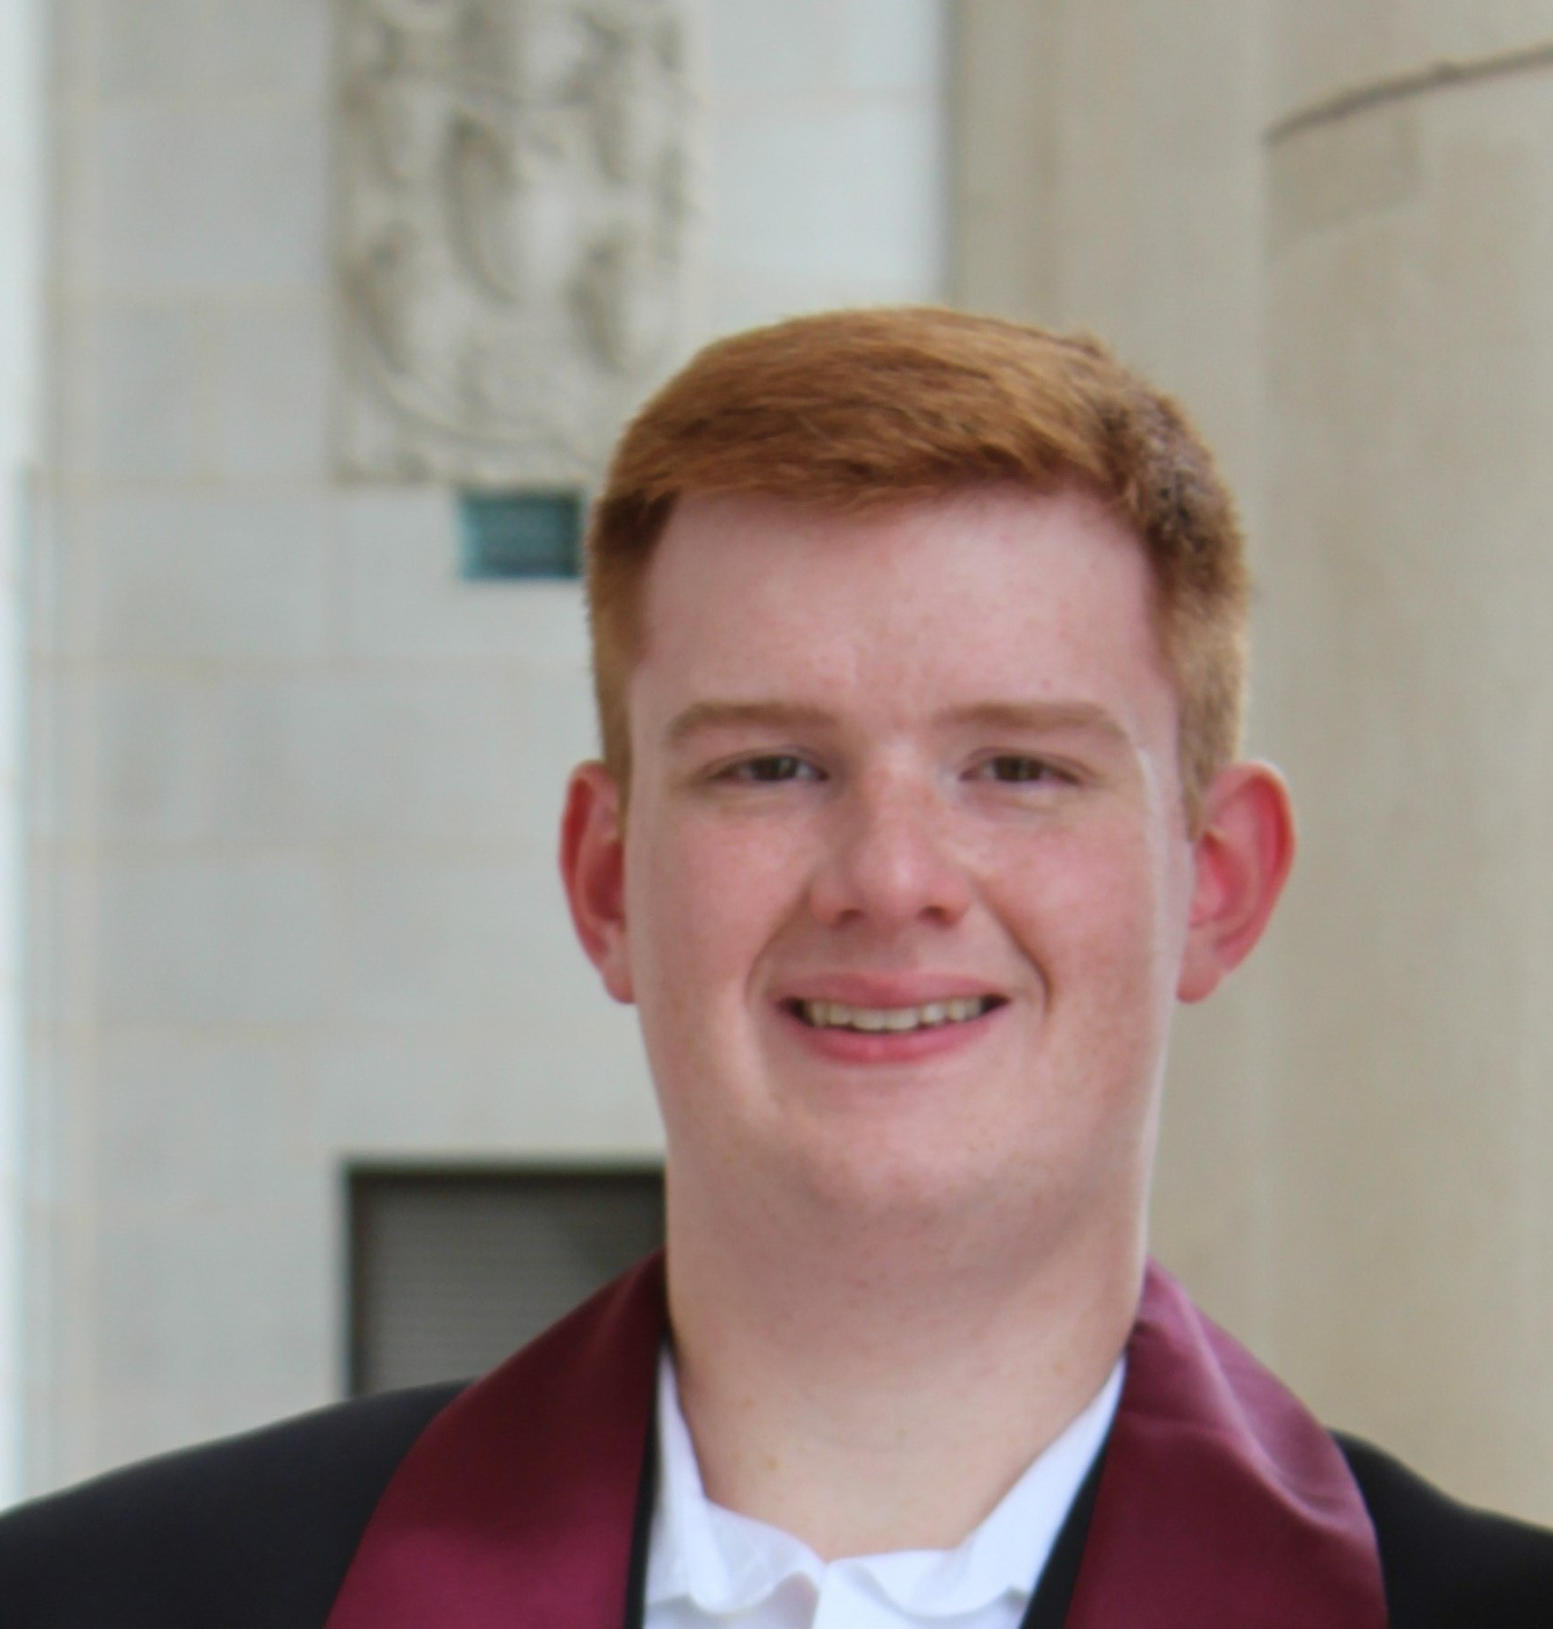
OUR TEAM
Matthew McCaskill
Consultant, Technology Solutions
Matthew McCaskill is a Consultant in Credera's Technology Solutions practice. Matthew specializes in frontend web technologies and mobile development but has experience in many areas of application development, such as Java, Kotlin, .NET, Swift, architecture, Flutter, and more. He received a B.S. in Computer Science with a minor in Math from Baylor University.​ He has built front-end applications for Novartis, Hilton, and Red Lobster.
Matthew loves to play board games and has over 80 in his collection!​ During my time at Baylor, I was a Supplemental Instructor and Event Coordinator for Wacode, the hackathon.
Matthew Becker
Consultant, Technology Solutions
Matthew’s passion in software stems from an enthusiasm for streamlining and simplifying processes through intentional and strategic changes addressing software shortcomings and human-factors. Working for a major shipping and logistics provider, Matthew spearheaded efforts to develop and implement a true end-to-end testing framework to replace laborious and ineffective manual processes. While working at a regional Telecom Provider, Matthew executed a DevOps modernization migration from Jenkins to GitLab. Since joining Credera, Matthew has become a certified Azure Developer and a Contentful Certified Professional. Matthew earned a Bachelor of Science in computer science with a minor in business from Texas A&M University in May 2022.
Matthew has a passion for aviation and is a certified private pilot.

Slide 5
Project Overview & Expectations

Slide 6
EXPECTATIONS
This semester, students are expected to embrace the role of a consultant on a real-world project, working with mentors to define, develop, and implement the product.
Student expectations
Students should expect to face a real-world situation where their team will take on a client. Mentors will be product owners as well as technical advisors.
Not every decision can be made by the mentors, many times it is up to the group to decide. Mentors are there to provide feedback and suggestions.
Students should expect to learn technologies on their own. This is something that would be expected of you on a real project . Mentors will help answer specific questions if they come up.
Mentors expect students to come prepared with specific questions that could be answered in scrum meetings. Make sure they are clear and concise instead of vague or general.

Slide 7
PROJECT OVERVIEW
Our company, StudyBuddies, Inc., wants to create a custom experience for students and tutors alike to allow them to plan study sessions anywhere, on and off campus.
PROJECT DESCRIPTION
The application will allow students to connect with tutors and other students and create study meetups with each other
They want an intuitive user experience coupled with powerful functionality
Your team has been given until the end of April to develop the application according to the requirements described in the SOW
PROJECT PLAN
JANUARY | FEBRUARY | MARCH | APRIL
MILESTONE 1
(Week of 2/11)
Spring Break
Project Kickoff
(1/23)
Setup team repository
Scaffold out pages with routing
Call example Java endpoint from client
MILESTONE 2
(Week of 3/10)
Sign in, registration, profile, and home page
Create a new meetup and add students/tutors
Automated Testing
Deploy template project to GCP
Set up continuous integration
MILESTIONE 3
(Week of 4/7)
Suggestions for other students and meetups related to preferences
Reminders before meetups
Rating the tutors after meetups
MILESTONE 4
Due at Final Presentation
(4/30)
Security
Final UX
Bonus features
Notes:
TM

Slide 8
MENTOR/TEAM COLLABORATION
Collaboration between mentors and teams will occur through Slack chats and weekly scrum meetings.
Contact
Best practices
Offline collaboration will primarily occur through your team’s dedicated Slack channel
Weekly scrum meetings will take place on Wednesday evenings. Each team will have a 20-minute time slot:
Team 1: 5:00-5:20pm
Team 2: 5:20-5:40pm
Team 3: 5:40-6:00pm
In each scrum meeting, teams will:
Discuss progress for the week and plans for next week
Review and discuss any artifacts or deliverables due that week (send artifacts in your team’s Slack channel by Tuesday so mentors have a chance to review)
Provide a brief demo of new functionality
Ask mentors questions to clarify their understanding
Come prepared to scrums with specific questions (e.g., requirement clarifications, technical questions about Spring, APIs, etc.) to discuss
When your team has a question, send it in your Slack channel so that the mentors and/or class TA can help answer it
If you need to miss a scrum meeting, send your update in chat ahead of time
Take advantage of your mentors’ expertise and experience

Slide 9
Technology Stack

Slide 10








TECHNOLOGY STACK
This semester your team will be using several technologies to build out the web app including Spring, REST, React, and MySQL.
Architecture Overview
API / Backend
(Server Side)
Web / Frontend
(Client Side)
Data Storage

Slide 11
TECHNOLOGY STACK
This semester your team will be using several technologies to build out the web app including Spring, REST, React, and MySQL.
SPRING
WHAT IS IT?
Spring (aka Spring Framework) is an open-source framework and inversion of control container for Java that was created to address the complexity of developing enterprise applications
Spring has layered architecture that allows developers to leverage certain components while not utilizing others that they may not care about
WHY ARE WE USING IT?
Spring is the most popular framework for Java applications and offers many features that we will take advantage of
Spring allows easy integration with other services, such as databases
HOW ARE WE USING IT?
We will leverage Spring’s built-in support for MySQL database connections and REST API creation

Slide 12
TECHNOLOGY STACK
This semester your team will be using several technologies to build out the web app including Spring, REST, React, and MySQL.
REST
WHAT IS IT?
Representational state transfer (REST) is an architecture that consists of a coordinated set of constraints that applies to components, connectors, and data elements
The REST architecture has been applied to developing web services and is commonly used as an alternative to SOAP and GraphQL
REST allows for data to be quickly obtained via point-to-point communications with clients using JSON
WHY ARE WE USING IT?
REST is the most common and simplest communication architecture on the web today
HOW ARE WE USING IT?
REST will be used to communicate between the frontend and backend

Slide 13
TECHNOLOGY STACK
This semester your team will be using several technologies to build out the web app including Spring, REST, React, and MySQL.
REACT
WHAT IS IT?
React is a JavaScript-based open-source web application framework for the application’s front-end that allows you to create dynamic views for your single-page application. It is a very widely-used platform and is thus many developers; go-to when creating a web application.
React allows you to declare re-usable, composable components that allows you to quickly and easily create interactive webpages written in a way that looks almost like normal HTML.
WHY ARE WE USING IT?
React is one of the most popular Javascript frameworks (#10 most stars on GitHub) and is common in industry
React is mature and has many available libraries to assist development, like component libraries and utility hooks
HOW ARE WE USING IT?
We will be using the Next.js framework to assist in creating and building our React components, as well as for easy routing

Slide 14
TECHNOLOGY STACK
This semester your team will be using several technologies to build out the web app including Spring, REST, React, and MySQL.
MYSQL
WHAT IS IT?
MySQL is a popular open-source relational database management system
WHY ARE WE USING IT?
Fast and reliable
Provides official Docker images maintained by the MySQL team for Linux platforms
MySQL is leading choice for SQL databases and is used in a wide variety of applications
HOW ARE WE USING IT?
MySQL will be the data store for this project
All information about students and meetups will be stored in and retrieved from MySQL

Slide 15
TECHNOLOGY STACK
This semester your team will be using several technologies to build out the web app including Spring, REST, React, and MySQL.
Architecture Overview
API / Backend
(Server Side)
Web / Frontend
(Client Side)
Data Storage

Slide 16
Template Project Walkthrough

Slide 17
Questions?

